Slide 1

Grab Driver Incentive Optimization Steering Committee Update #2
02 November 2016

Slide 2
Project Timeline
The project is in Week 9. Segmentation model is 90% developed and refinement of churn model is completed. Following value realization assessment of the segments, initial incentive campaigns ideas are being outlined.
Current week

Slide 3
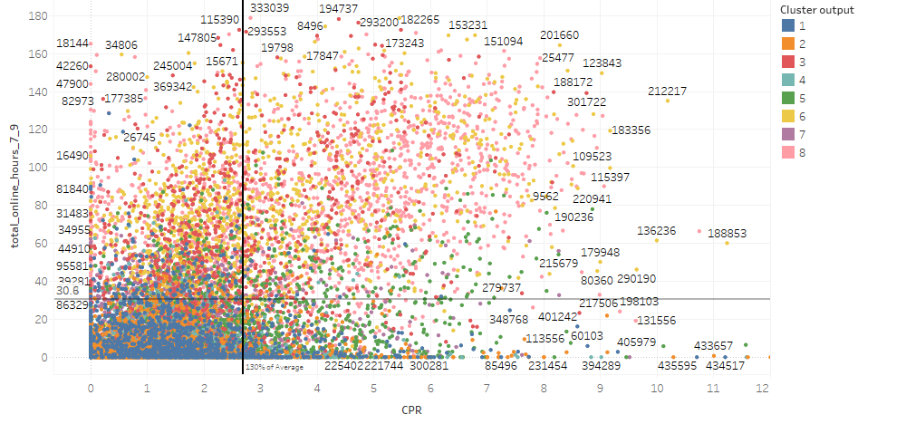
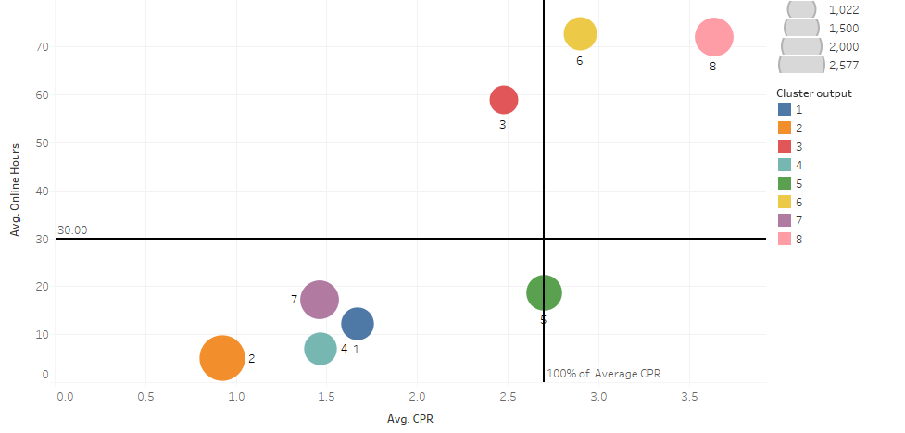
Based on the clustering of drivers’ online activity, there are distinct behavior which pose different cost and supply implications and present opportunities to optimize driver incentives. Overlaying quadrant on top of clusters gives a list of potential drivers who have shown behavior to drive on weekday morning.
Behavior based segmentation provides an opportunity to reducing overall CPR while matching peak hour demand
Total of 13724 drivers active during the 9 weeks period.
Total online hours
2704
2151
7479
1390
CPR
Quadrant analysis based on averages CPR and online hours (Weekday morning peak)
Clusters overlay over quadrant analysis

Slide 4


Segmentation
Churn model
Incentives
Main Findings
1
Segment 6 & 8 are important to Grab, currently meeting peak hour demand, but the CPR is expensive to Grab
2
Segment 4 appears to be constrained by post working hours, Grab should continue the current incentive
3
Passive segment 2 requires incentive that may encourage response, and thus help understand the driving behavior
4
Segment 3 has the potential to maximize their capacity, with the aim of increasing engagement with Grab
5
Drivers that are likely to churn, have lower tenure, lower income, lower total distance driven
6
The churn model can predict potential churn using 6 months of drivers’ data with approx. 84% accuracy on out of sample data
7
Segment 5 & 7 are the best candidate for addressing the supply and demand gap during critical morning peak hours

Slide 5
Agenda
Segmentation Model & Insights
Churn propensity model
Value realization analysis

Slide 6
Overall Approach for Segmentation Model
Establish Driver Segmentation
Opportunity sizing
Outline of incentive campaign by optimizing segments
Segmentation of drivers performed based on driver’s online activity.
Identify driver segments that can potentially reduce CPR and increase capacity
Passive Segment
Further information is required and may be gathered through incentive campaigns aimed at discovering their underlying behavior

Slide 7
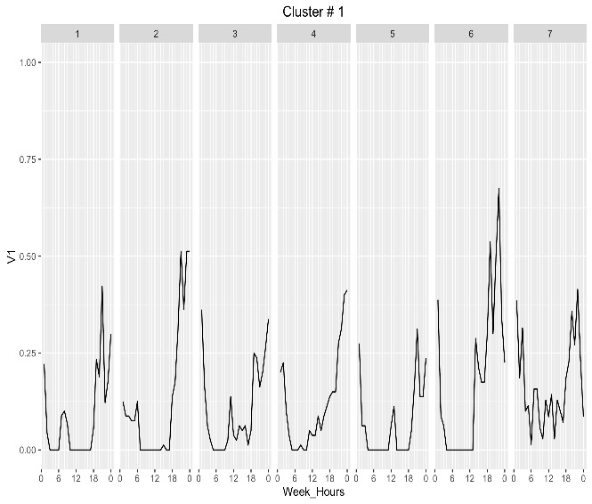
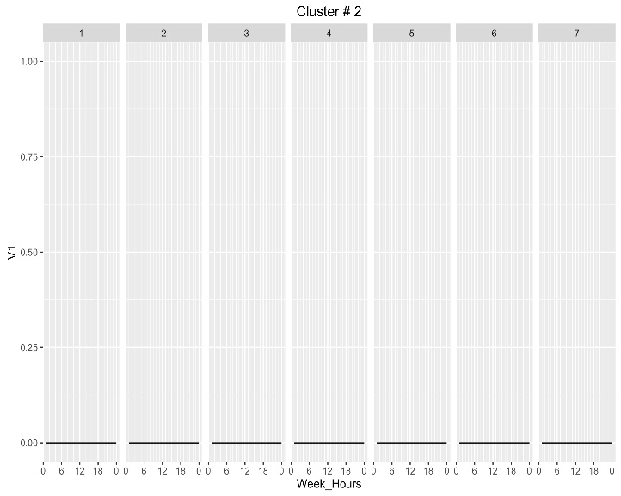
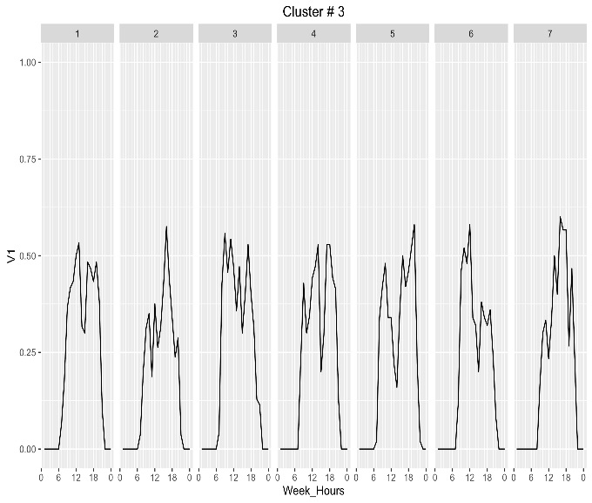
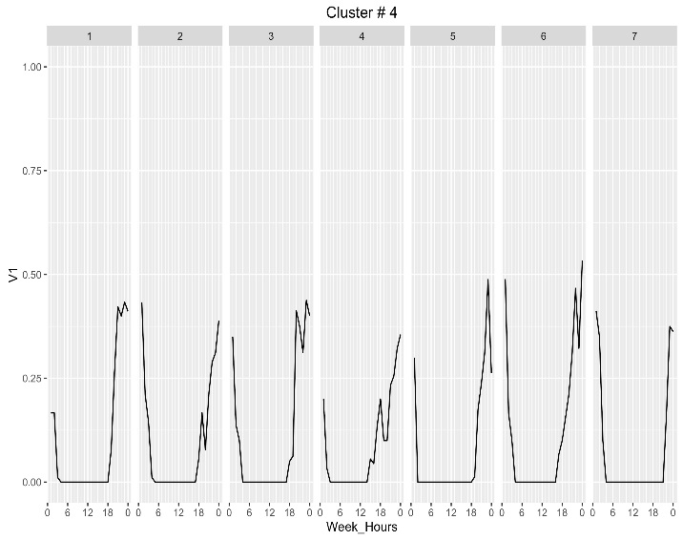
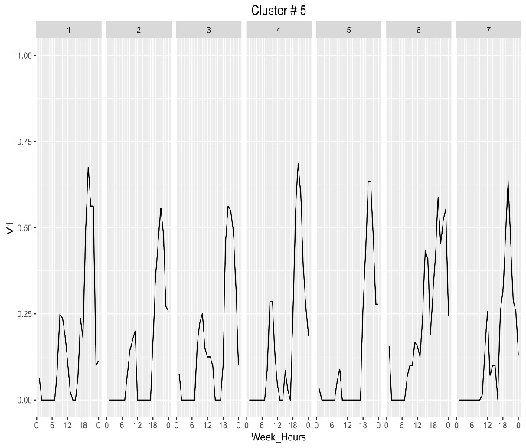
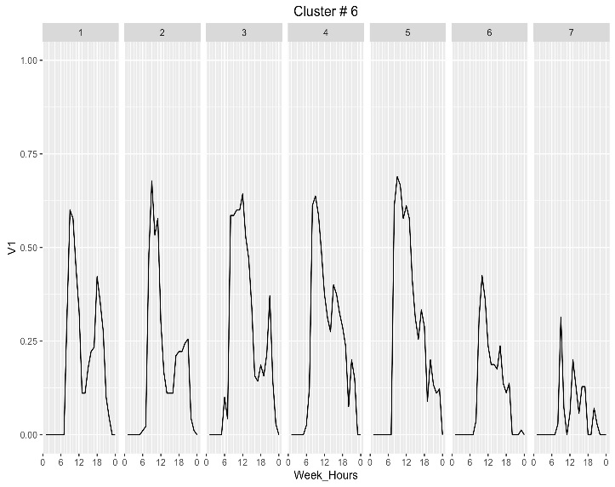
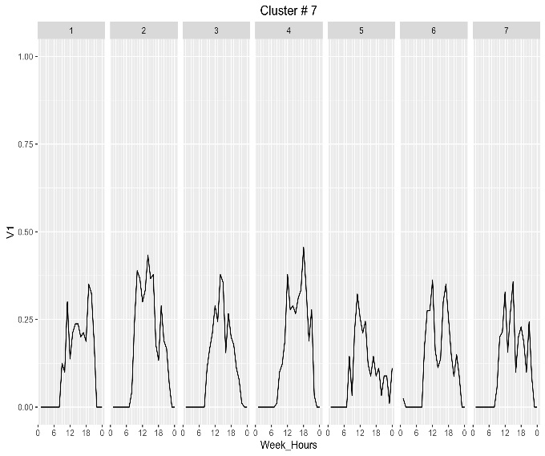
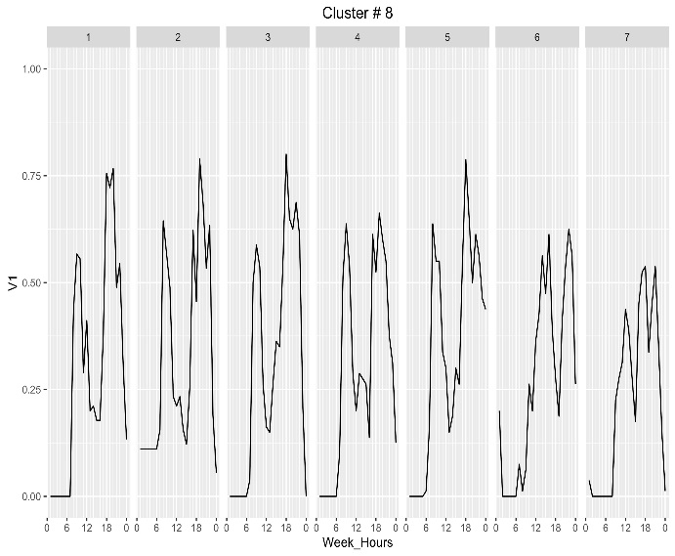
We applied dynamic time warping to cluster driver’s temporal online activity and identified eight distinct driver’s behaviors
Intensity of average online hours
Mon
Tue
Wed
Thu
Fri
Sat
Sun
Intensity of average online hours
Segment 1
Segment 2
Segment 3
Segment 4
Segment 5
Segment 6
Segment 7
Segment 8

Slide 8






Segment summary
Evening peak/night drivers
Least active drivers
Day time
drivers
Evening peak/night drivers
Evening peak oriented drivers
High activity AM peak drivers
Day time drivers
High activity 2 peak drivers
10%
20%
8%
10%
12%
11%
14%
15%
1355
2581
1022
1336
1588
1383
1855
1854
Drivers with highest percentage of young adults (below 35 yo) and relatively new to Grab with 60% joined Grab less than 6 months
Drivers with highest percentage of uber users, highest percentage of people who completed less than 25 trips in a week
Though low tenure and dominantly middle-age group of drivers, it has the highest percentage of drivers with taxi license and 2nd highest fuel card
Dominant group of young adults with relatively new to Grab, with 99% of the drivers in this cluster who completed less than 75 trips weekly
More middle age drivers in this segment with 2nd highest segment with tenure less than 9 months, this segment also has relatively low trips in a week
Middle age drivers with recognizable tenure with Grab, this segment has the best performance in AR and CR
Mix age group, average performance in AR & CR, 96% of drivers complete less than 50 trips weekly and no driver completes more than 75 trips weekly
Highly affiliated to Grab, highest percentage of lifetime trips more 1000, highest fleet exclusive and also the highest fuel card adoption
CPR
CPR
CPR
CPR
CPR
CPR
CPR
CPR
SGD 1.60
SGD 0.90
SGD 2.40
SGD 1.40
SGD 2.70
SGD 2.90
SGD 1.40
SGD 3.60

Slide 9
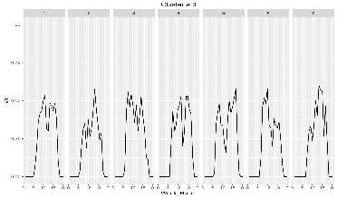
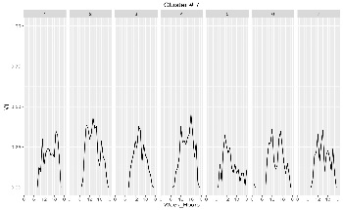
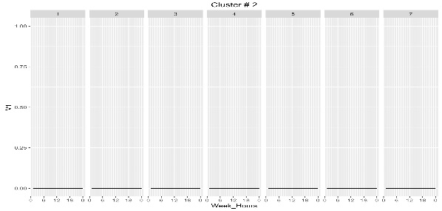
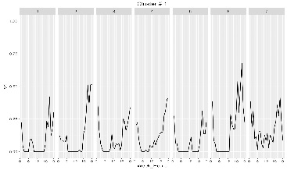
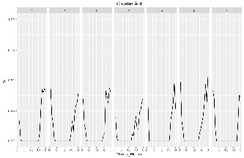
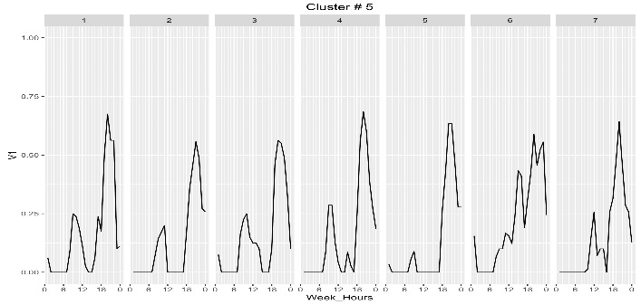
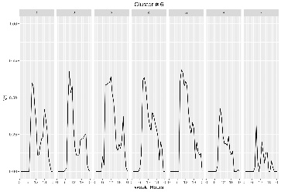
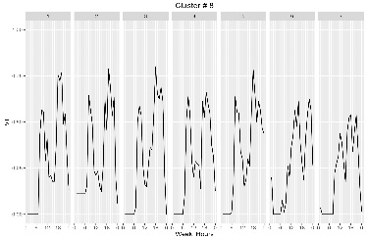
Cluster 3 (8%)
Cluster 7 (14%)
Day time drivers
(Segment 3 & 7)
Evening/night drivers
(Segment 1 & 4)
Evening peak hour drivers
(Segment 5)
Least active drivers
(Segment 2)
High activity drivers
(Segment 6 & 8)
Driving Behavior is consistent during weekday (From 7am to 9pm daily)
Middle aged drivers (Above 45 yo)
Cluster 2 (20%)
Drivers with significantly low weekly activities during the aggregated
9 weeks
Cluster 1 (10%)
Cluster 4 (10%)
Most active during evening/night
Young adults (High % of 20 – 35 yo)
Behavior is consistent during weekday (From 7am to 9pm daily)
Cluster 5 (12%)
Evening peak hour drivers
Less active in the morning
Driving activity starts earlier on weekends than on weekdays
Cluster 6 (11%)
Cluster 8 (15%)
Consistently online throughout the week with high activity during the weekday
Markedly lower activity on weekends

Slide 10
Cluster 3 (8%)
Cluster 7 (14%)
Day time drivers
(Segment 3 & 7)
Evening/night drivers
(Segment 1 & 4)
Evening peak hour drivers
(Segment 5)
Least active drivers
(Segment 2)
High activity drivers
(Segment 6 & 8)
Driving Behavior is consistent during weekday (From 7am to 9pm daily)
Middle aged drivers (Above 45 yo)

Slide 11


Day time drivers
Segment 3 shows regular driving behavior, Grab can consider to spend more incentives on this segment to retain and encourage the drivers to be even more active
Who are they?
Implications
Size of cluster: 1022 (8%)
Avg. CPR: $2.40
Highest proportion of drivers > 45 years old
High tendency towards loyalty type incentive schemes
Lowest % of Uber users
High % of fuel card users
Over 50% drivers complete 25-75 weekly trips
Average = 42%
1. Increasing and maintaining the ‘stickiness’
Uber users
2. CPR of $2.40 is below the overall CPR average
Consistent driving behavior during the day
3. Targeting to increase weekly number of rides, since they already are consistently driving throughout the day
Average Weekly trips
Notes:
Segment 8

Slide 12
Day time drivers
Segment 5 have the potential to grow, to take more rides with Grab, securing their commitment is the key
Who are they?
Implications
Size of cluster: 1855 (14%)
Avg. CPR: $1.40
96% drivers complete under an average of 50 trips in a week
High % drivers of Uber users
Majority of drivers responded to “Extra cash top-up without any target”
1. Though driving daily throughout the day, weekly rides fall under 50 rides
Weekly trips
2. Tend to respond more towards “without target” type schemes.
3. Grab can focus on incentives that encourage more trips and long term commitment.
Incentive payout
Notes:
Segment 8

Slide 13
Day time drivers
(Segment 3 & 7)
Evening/night drivers
(Segment 1 & 4)
Evening peak hour drivers
(Segment 5)
Least active drivers
(Segment 2)
High activity drivers
(Segment 6 & 8)
Cluster 1 (10%)
Cluster 4 (10%)
Most active during evening/night
Young adults (High % of 20 – 35 yo)
Behavior is consistent during weekday (From 7am to 9pm daily)

Slide 14
Evening peak/night drivers
Segment 1 usually drives at night till past mid night, Grab can consider to ‘stretch’ their driving hours
Who are they?
Implications
Size of cluster: 1355 (10%)
Avg. CPR: $1.60
60% of the drivers with tenure less than 6 months
Over 50% of drivers are between the ages of 25-40 years old
High % of drivers make 50 trips or less in a week
1. This segment represents drivers who are meeting the evening peak demand
2. Grab may consider offering incentives aimed at maximizing their evening and weekend capacity
Late night driving
3. Large proportion of drivers who are making under 25 trips in a week.
Weekly trips
Notes:
Segment 8

Slide 15
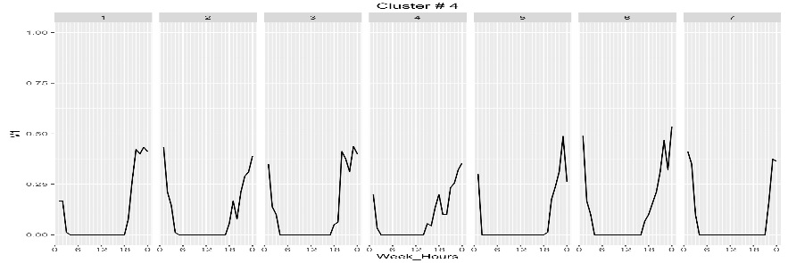
Evening peak/night drivers
Segment 4 shows fixed driving pattern, Grab should maintain the current incentives to this group of drivers
Who are they?
Implications
Size of cluster: 1336 (10%)
Avg. CPR: $1.40
60% drivers are between the ages of 25 to 40.
Relatively new to Grab (61% less than 6 months)
Over 90% of drivers made 50 or less trips in a week
1. The driving activity of this segment appears to be constrained by evening peak hours
2. Large % of drivers have the ability to qualify for incentives with target fares.
Evening peak and night driving behavior
3. It is recommended that we maintain their current incentive schemes offered.
Incentive payout
Notes:
Segment 8

Slide 16
Day time drivers
(Segment 3 & 7)
Evening/night drivers
(Segment 1 & 4)
Evening peak hour drivers
(Segment 5)
Least active drivers
(Segment 2)
High activity drivers
(Segment 6 & 8)
Cluster 6 (11%)
Cluster 8 (15%)
Consistently online throughout the week with high activity during the weekday
Markedly lower activity on weekends

Slide 17

High activity AM peak drivers
Optimizing segment 6 by encouraging more rides in AM peak potentially testing the capacity of PM peak
Who are they?
Implications
Size of cluster: 1383 (11%)
Avg. CPR: $2.90
51% of drivers age above 45 yo
45% of drivers have tenure between 6-1.5 years
Highest response towards loyalty program type of schemes
1. One of the two most important segments to Grab in meeting morning peak hour demands.
2. CPR for this segment is relatively similar to the overall average CPR of $2.70
Highly intense morning peak drivers
3. Grab could introduce incentives aimed at maximizing their trip capacity for morning peak hours.
Notes:
Segment 8

Slide 18
High activity 2 peak drivers
Segment 8 is costly to Grab, but it is also ‘sticky’, consistently active and engaged during peak hours
Who are they?
Implications
Size of cluster: 1854 (15%)
Avg. CPR: $3.60
75% of the drivers with tenure more than 6 months
Over 51% of drivers over the age of 45
Highest percentage of fuel card users, fleet exclusive along with highest response to loyalty type programs
Highest percentage of more than 1000 lifetime trips
1. Currently meet the demands for both evening and morning peak hours and are the most loyal in terms of fleet exclusivity and fuel card users.
Average = 23%
Fleet exclusivity
2. However they are also the most expensive segment, where their CPR is more than double that of the evening/ night time peak hour drivers.
Average = 6%
3. Later stage should consider revising their incentives offered to this segment, once peak hour demands are being sufficiently met through other driver segments.
Fuel card
Dual peak hour driving
Notes:
Segment 8

Slide 19
Day time drivers
(Segment 3 & 7)
Evening/night drivers
(Segment 1 & 4)
Evening peak hour drivers
(Segment 5)
Least active drivers
(Segment 2)
High activity drivers
(Segment 6 & 8)
Cluster 5 (12%)
Evening peak hour drivers
Less active in the morning
Driving activity starts earlier on weekends than on weekdays

Slide 20

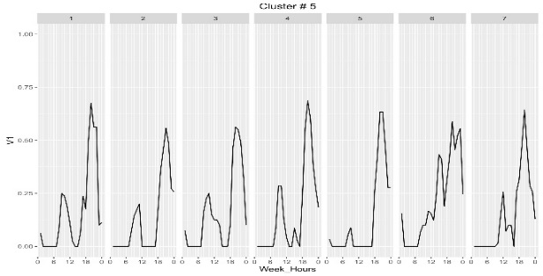
Evening peak oriented drivers
Segment 5 complements with Segment 6, by encouraging more rides in the PM peaks
Who are they?
Implications
Size of cluster: 1588 (12%)
Avg. CPR: $2.70
50% of drivers are aged between 25-40 years old
This segment has the highest response towards loyalty programs
73% drivers made < 50 weekly trips
1. This segment is important in meeting the evening peak hour demands at the average CPR.
2. Grab can consider proposing incentives aimed at increasing their number of rides during their evening hour peak hour driving.
Highly intense evening peak drivers
Notes:
Segment 8

Slide 21
Day time drivers
(Segment 3 & 7)
Evening/night drivers
(Segment 1 & 4)
Evening peak hour drivers
(Segment 5)
Least active drivers
(Segment 2)
High activity drivers
(Segment 6 & 8)
Cluster 2 (20%)
Drivers with significantly low weekly activities during the aggregated
9 weeks

Slide 22

Least active drivers
Segment 2 is very inactive, Grab should consider to plan incentive to understand the segment better
Who are they?
Implications
Size of cluster: 2581 (20%)
Avg. CPR: $0.90
Lowest percentage of fuel card consumption
1. This segment represents the largest cluster and they have the highest propensity to churn.
Average = 42%
99% of the drivers who complete less than 25 trips weekly
Further sub-clustering was performed to examine if any similarities exist between the sub-clusters and other segments.
2 . Segment 2 also has the highest % of Uber users
Uber user
3 . Grab may consider incentive schemes that will encourage an increase in their online activity, so as to uncover their inherent driving behavior
Insignificant active online hours
Notes:
Segment 8

Slide 23
Least active drivers
Due to the low average online
activity across 9 weeks,
the driver’s activity based on
sum of online hours for all drivers
within this segment is examined
2A
2B
2C
95% of drivers in segment 2B completed less than 5 trips in a week
Segment 2C has the highest percentage of Uber driver (60%)
Segment 2A has consistent high activity on Tuesday
Total sum of online hours

Slide 24
Agenda
Segmentation Model & Insights
Churn propensity model
Value realization analysis

Slide 25
Overall Approach for Churn Model
Definition of Churn
Prediction of Churn
Churn validation for each segment
Value-At-Risk for each segment
Recommendation
Identify a churn threshold based on the distribution of consecutive weeks with an absence of rides
Gradient Boosting Machine (GBM) learning technique is implemented. Training dataset comprise of 80% of drivers for the period of January-June
Out of sample model validation is performed on a testing set comprising of 20% of drivers for the period of July-August. The churn value of a segment is calculated
A churn rate of each segment is given and the associated revenue and CPR for each segment is used to determine the value-at-risk
Determine the incentives to provide to target driver groups for retention

Slide 26
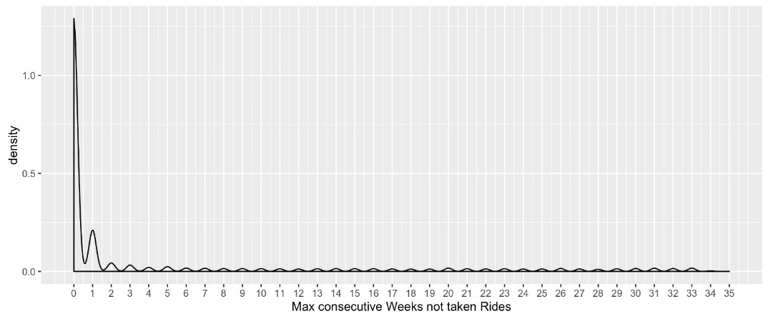
Driver churn is defined using a data-driven approach and applied a Gradient Boosting Machine technique was implemented
Definition of Churn
Prediction of Churn
Churn validation for each segment
Value-At-Risk for each segment
Recommendation
Number of consecutive weeks (from January to August 2016) for which there are no activity is examined
An absence of activity of 4 consecutive weeks is a strong indicator of churn
Identification of churn based on definition
5K Drivers not driving on last 4 weeks of data (1st-28th August) - considered as churned.
360 Drivers Banned drivers also marked as Churned.
816 Terminated Driver Accounts also marked as Churned.
Data
Cleaned and Formatted
Tree-based Algorithm
Gradient Boosted Trees
Predicts Driver’s Churn Propensity
Notes:
1. Prediction is done by a ensemble of trees or estimators
2. Builds a collection of trees 1 by 1 and then prediction of individual trees are summed
3. Uses ensemble of weaker decision Tree models

Slide 27
Original data variables were transformed to reflect likely churn behavior
Definition of Churn
Prediction of Churn
Churn validation for each segment
Value-At-Risk for each segment
Recommendation
More than 100 number of variables were included as churn predictors in the churn model
Raw variables
Distances for each driver ID
Incomes for each driver ID
Number of Rides for each driver ID
Acceptance rates for each driver ID
Cancellation rates for each driver ID
Tenure
Taxi license
Uber user
Rate of change
Weekly rate of change (Distance)
Weekly rate of change (Income)
Weekly rate of change (Rides)
Weekly rate of change (Acceptance rate)
Weekly rate of change (Cancellation rate)
Overall trend of weekly distance
Overall trend of weekly income
Overall trend of weekly rides
Overall trend of weekly acceptance rate
Overall trend of weekly cancellation rate
Indexing/Deciles
Index for distance (driver ID) against distance (driver population)
Index for income (driver ID) against income (driver population)
Index for number of rides (driver ID) against number of rides (driver population)
Index for acceptance rate (driver ID) against acceptance rates (driver population)
Index for cancellation rate (driver ID) against cancellation rate (driver population)
………..
Weekly sum of incentive
Car Type (4 seater/6 seater)
Acceptance rate
Cancellation rate
Number of 5 star ratings
.
.
.
Number of 1 star ratings
Average ratings
Total number of rides
Total distance
Average ride distance
Total Fare
Total distance (for 5 time blocks)
Total rides (for 5 time blocks)
Notes:
Appropriate transformations for the data were taken to reflect likely churn behavior.

Slide 28
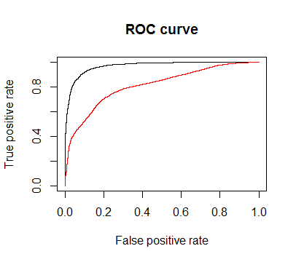
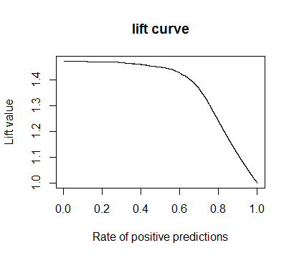
The refined model had an overall accuracy of 91% and is able to predict 80% of churn drivers accurately.
Definition of Churn
Prediction of Churn
Churn validation for each segment
Value-At-Risk for each segment
Recommendation
In the top 10 decile, the lift is at its maximum (at 1.4). The model is able to predict accurately for 7 deciles of the data before reducing by about 14% in lift for the 8th decile
Refined churn model
The top 25 churn predictors are able to explain more than 80% of variation in the model
Drivers who are most likely to churn have:
Shorter tenure
Lesser income
Shorter distance
Lower rank for acceptance rate in Week 1
Lower rank for cancellation rate in Week 1
Initial churn model
Towards least likely to churn
Tenure:+ve
Acceptance rate mean: -ve
Acceptance rate rank for week 1 = +ve
Income rank for week 1 = -ve
Cancellation rate rank for week 1 = +ve
Acceptance rate of change in week 1 and 2= -ve
Income mean = +ve
Distance min = +ve
Observed July status
 | Churn | Not Churn
Churn | 652 | 154
Not Churn | 301 | 1820
Predicted July status
The model is able to predicts 80% churn drivers correctly.
Notes:
91% vs 72%. Based on the random
0 – churn, 1 Not churn

Slide 29
Churn score for each of the segment is of the segments (It is determined by out of sample data set)
Definition of Churn
Prediction of Churn
Churn validation for each segment
Value-At-Risk for each segment
Recommendation
High activity 2 peak drivers
Day time
drivers
High activity AM peak drivers
Evening peak oriented drivers
Day time drivers
Evening peak/night drivers
Evening peak/night drivers
Least active drivers
15%
8%
11%
12%
14%
10%
10%
20%
1854
1022
1383
1588
1855
1355
1336
2581
Churn Score
0.785
Churn Score
0.779
Churn Score
0.774
Churn Score
0.771
Churn Score
0.7577
Churn Score
0.7576
Churn Score
0.755
Churn Score
0.677
CPR
CPR
CPR
CPR
CPR
CPR
CPR
CPR
SGD 3.60
SGD 2.40
SGD 2.90
SGD 2.70
SGD 1.40
SGD 1.60
SGD 1.40
SGD 0.90
Least likely to churn
Most likely to churn

Slide 30
Agenda
Segmentation Model & Insights
Churn propensity model
Value realization analysis

Slide 31
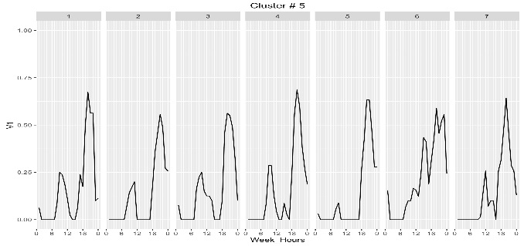
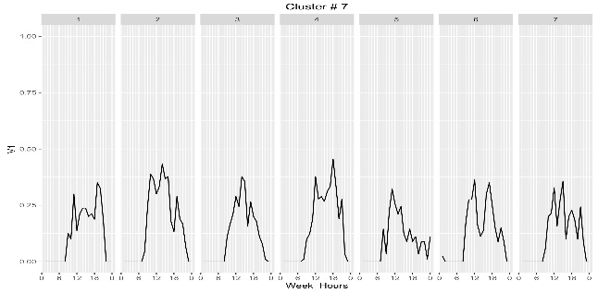
Behavior Segment to best match peak demand - I
Demand Gap
For 7 to 9 AM
Weekdays
Source: Grab
Week on week % of online drivers for 7 to 9 , 5 to 6 and 10 to 11 time blocks.
Heat map represents red color for cluster with very high number of active drivers during the peak hour.
7 to 9 AM % online Drivers
5 to 6 AM % online Drivers
% Change in early morning and Peak Hour
Segment 5
Segment 7
Based on the driving behavior both cluster 5 and 7 have potential to drive more on AM peak.
Just 25% of drivers from these clusters are online during this peak period.
Analyzing before and after 2 hours of data to find the percentage change of drivers coming online only for this peak hour. Result indicate cluster 5 and 7 have around 15-20% change where as other clusters serving peak demand change more than 30 %.
7 to 9 AM % online Drivers
9 to 10 AM % online Drivers
% Change in Peak Hour and after Peak
% Change in early morning and Peak Hour
%change between time blocks 7 to 9 ,
5 to 6 and 10 to 11 time blocks.

Slide 32
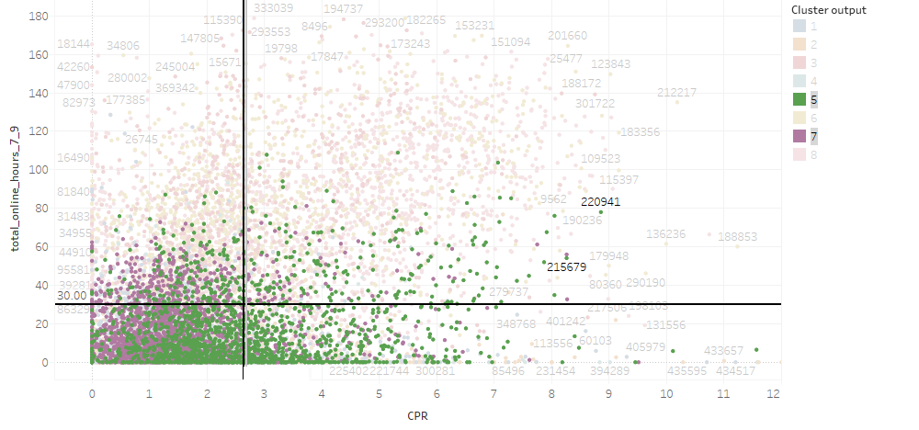
Behavior Segment to best match peak demand - II
Analyzing potential is locked hidden in segments 5 & 7.
Average Capacity of segment 5 & 7 (Week on Week) = 25%
Maximum Possible Capacity (Drivers taken at-least one ride from 7am to 9am from Monday to Friday) of segment 5 & 7 = 64%
Drivers who have not achieved maximum capacity= 64% - 25% = 39% (~1300 drivers)
With 1300 more drivers we would be able to meet 8 out of 9 times the peak hour demand completely and 70% for last one time.
Campaign to be designed to encourage more drivers from cluster 5 & 7 to be online during peak AM hours on weekdays.
Clusters overlay over quadrant analysis
700
548
 | 7 | 8 | 9
Mon | 400 | 900 | 300
Tues-Thurs | 300 | 500 | 300
Fri | 1200 | 1900 | 1000
Meets demand completely during these hours
Meets 70% of the demand
1300
800
Demand Supply gap.
Segment 5 & 7

Slide 33
Work plan and Next Steps
Finalized segmentation and churn models (4th November)
Value realization analysis
Incentive campaign execution and evaluation
Key Stakeholders Engagement Plan
Session | Date | Agenda
Knowledge Transfer | 7th-11th November 2016 | Transfer of code used in data preparations and model development
Final presentation of campaign results | 25th November 2016* | Presentation of key results from execution of incentive campaigns
* Dates and Time to be confirmed by Grab based on stakeholder availability

Slide 34

About Accenture Analytics
Accenture Analytics, part of Accenture Digital, delivers insight-driven outcomes at scale to help organizations improve their performance. With deep industry, functional, business process and technical experience, Accenture Analytics develops innovative consulting and outsourcing services for clients to help ensure they receive returns on their analytics investments. We have a global network of over 17000 Analytics professionals with extensive capabilities that range from accessing and reporting. Accenture Analytics is a Leader in Gartner’s Magic Quadrant for Business Analytics
Follow @ISpeakAnalytics or visit www.accenture.com/analytics.
About Accenture
Accenture is a global management consulting, technology services and outsourcing company, with approximately 266,000 people serving clients in more than 120 countries.
Combining unparalleled experience, comprehensive capabilities across all industries and business functions, and extensive research on the world’s most successful companies, Accenture collaborates with clients to help them become high-performance businesses and governments. The company generated net revenues of US$31 billion for the fiscal year ended Aug. 31, 2015 Its home page is www.accenture.com.

Slide 35
APPENDIX

Slide 36
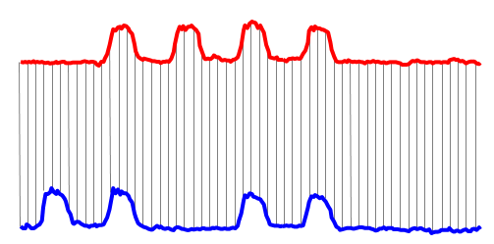
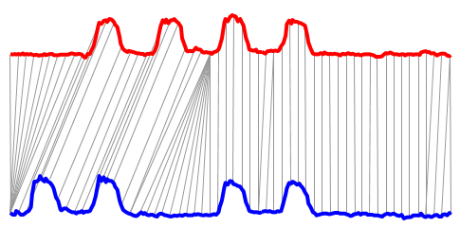
Dynamic time warping is a robust time series based clustering technique, for measuring the similarity between temporal sequences
Based on the measurement of clustering distances, DTW performed much better than Euclidean distance (which was used as a metric in the previous clustering methodology) for classification, clustering, query by content etc.
Euclidean Distance
Sequences are aligned “one to one”.
“Warped” Time Axis
Nonlinear alignments are possible.
γ(i,j) = d(q_{i},c_{j}) + min{ γ(i-1,j-1) , γ(i-1,j ) , γ(i,j-1) }
Q
Euclidean Distance Error rate 26.10%
Dynamic Time Warping Error rate 2.87%
C

Slide 37
Bin | C1 | C2 | C3 | C4 | C5 | C6 | C7 | C8
0.5 to 1 | 9.17% | 22.92% | 4.91% | 9.95% | 2.88% | 2.64% | 10.76% | 5.19%
1 to 1.5 | 17.05% | 23.75% | 6.35% | 19.37% | 5.75% | 6.20% | 20.86% | 3.39%
1.5 to 2 | 20.95% | 18.74% | 14.15% | 25.27% | 11.06% | 12.76% | 27.21% | 4.48%
2 to 2.5 | 18.73% | 11.67% | 16.84% | 17.46% | 17.00% | 16.54% | 16.78% | 9.51%
2.5 to 3 | 11.77% | 6.72% | 16.46% | 13.02% | 14.75% | 13.40% | 9.77% | 9.46%
3 to 3.5 | 7.65% | 4.36% | 9.62% | 5.74% | 13.38% | 10.12% | 4.64% | 9.51%
3.5 to 4 | 4.13% | 2.59% | 6.26% | 2.53% | 9.06% | 6.84% | 2.92% | 6.45%
4 to 4.5 | 2.29% | 1.77% | 5.29% | 1.76% | 5.94% | 6.56% | 1.88% | 6.62%
4.5 to 5 | 2.14% | 1.47% | 5.29% | 1.15% | 4.63% | 4.06% | 0.88% | 6.29%
5 t o 10 | 4.13% | 4.30% | 12.80% | 1.91% | 14.06% | 19.03% | 3.04% | 37.83%
10 to 15 | 1.07% | 0.88% | 0.96% | 0.84% | 0.75% | 1.00% | 0.66% | 0.66%
15 to 20 | 0.84% | 0.77% | 0.96% | 0.92% | 0.69% | 0.78% | 0.55% | 0.55%

Slide 38
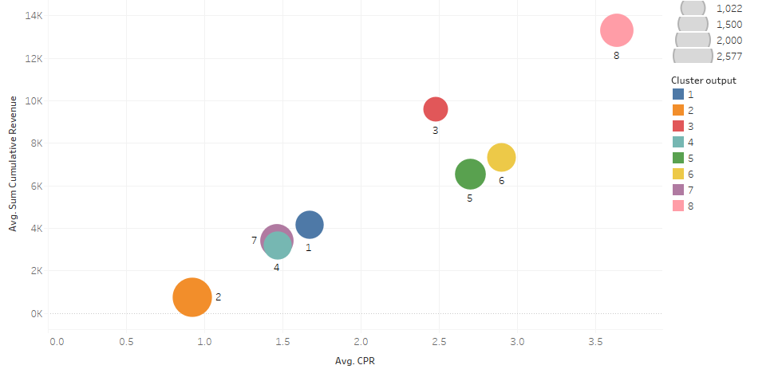
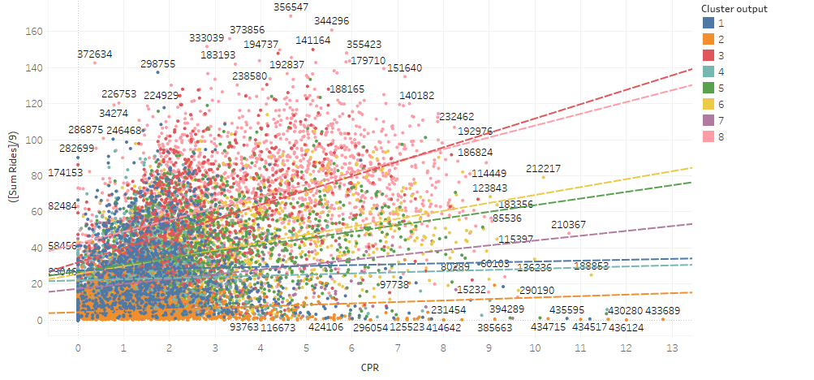
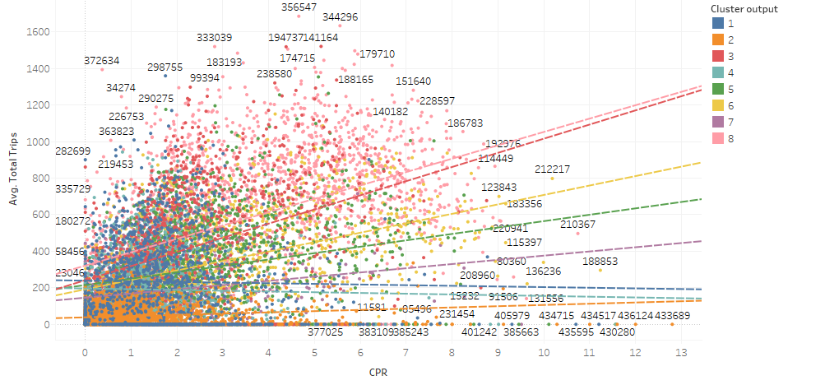
Overall revenue vs. CPR
Overall weekly trips vs. CPR
Overall trips vs. CPR

Slide 39
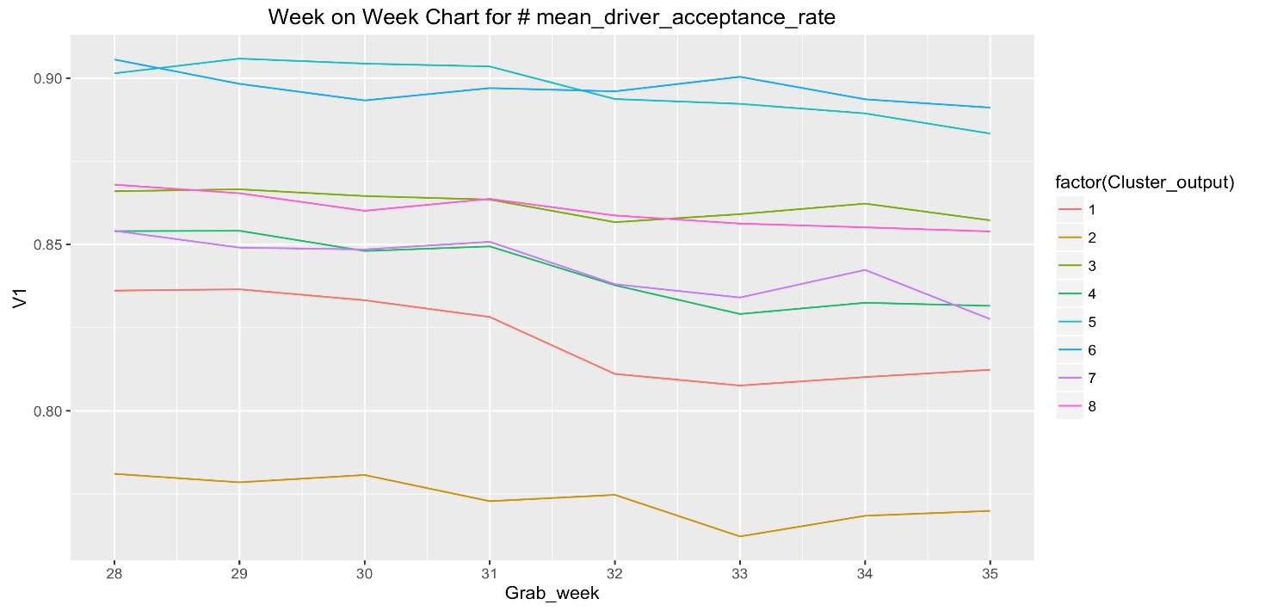
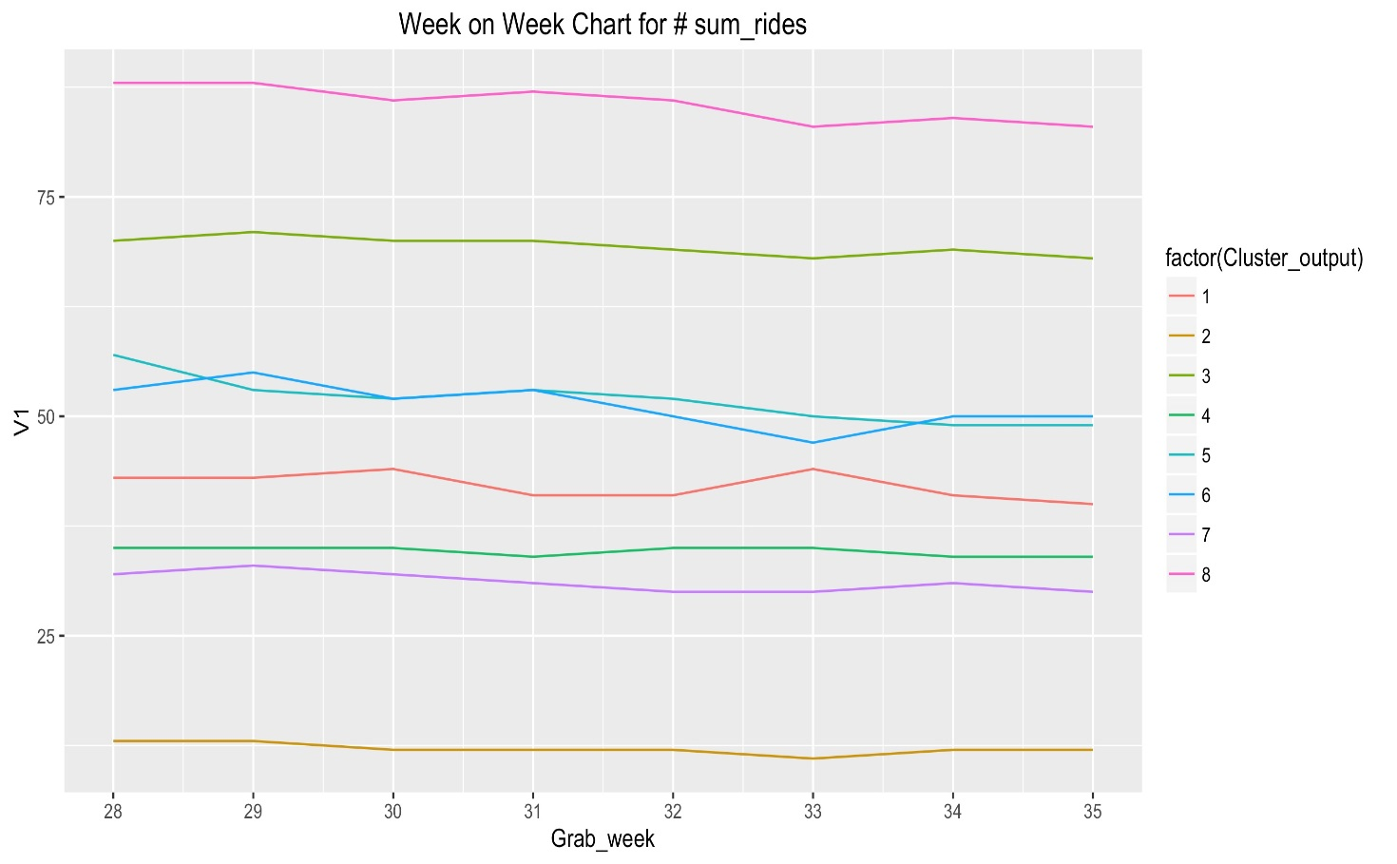
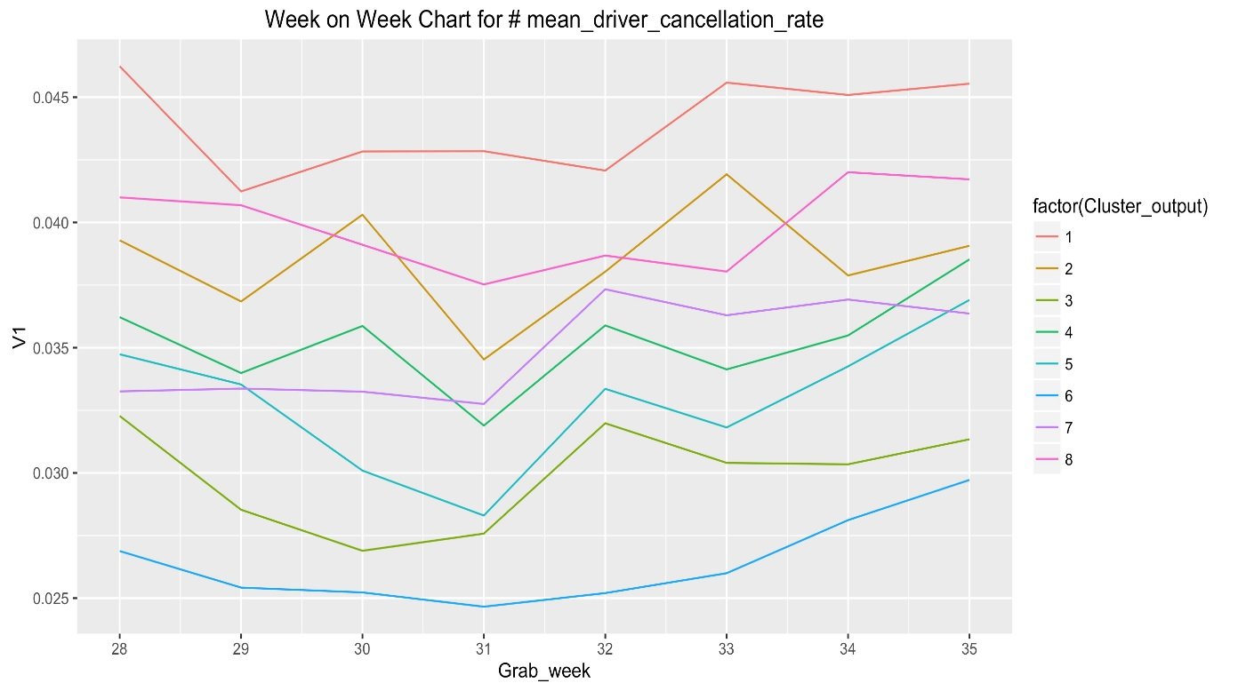
Acceptance rate (Week on week)
Total # of rides (Week on week)
Cancellation rate (Week on week)

Slide 40
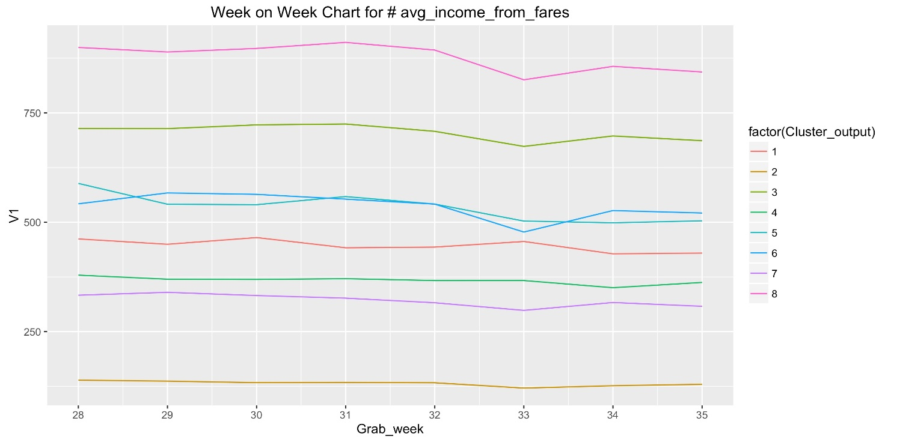
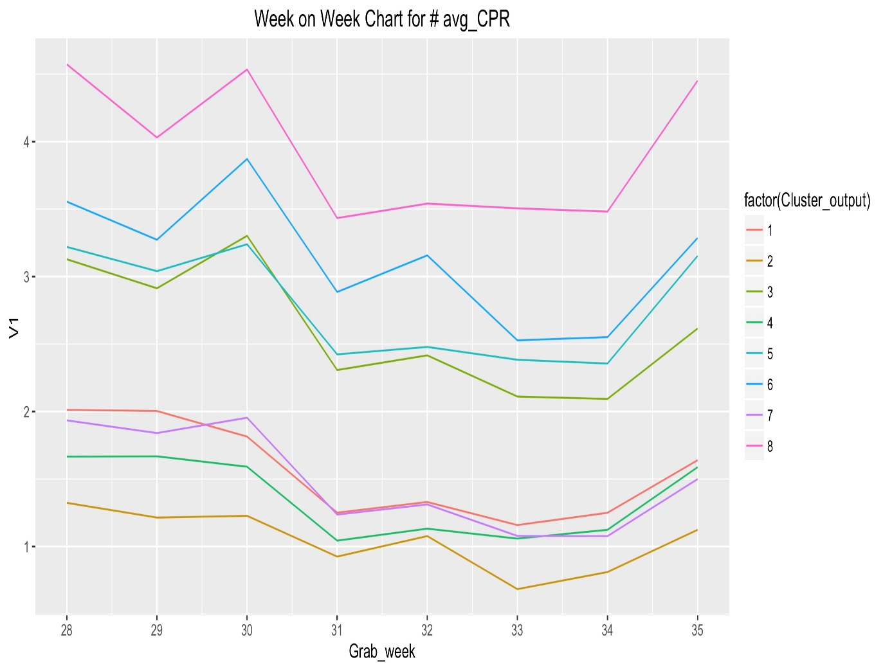
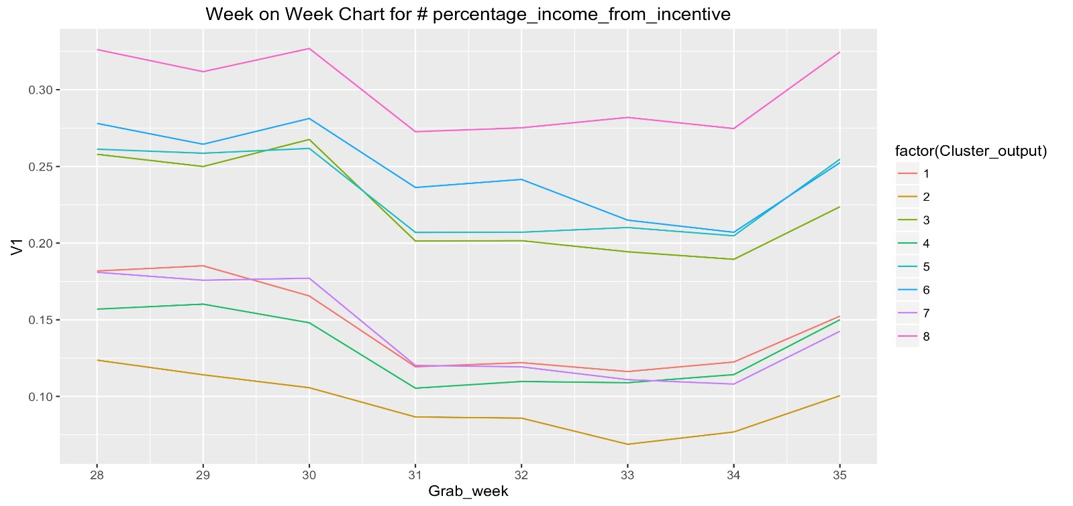
Average income from fares (week on week)
Average CPR (Week on week)
% of income from fares (week on week)

Slide 41
Day time drivers
Who are they?
7am
6pm
7am
6pm
Size of cluster: 1022 (8%)
Avg. CPR: $2.40
Highest proportion of drivers > 45 years old
High tendency towards loyalty type incentive schemes
Lowest % of Uber users
High % of fuel card users
Over 50% drivers complete 25-75 weekly trips
Age
Consistent driving behavior during the day
Average = 6%
Incentive payout
Fuel card consumption
Implications
Average = 42%
Grab could look at increasing and maintaining the stickiness of this segment since their CPR of $2.40 is below the overall CPR average, whilst increasing their weekly number of rides, since they already are consistently driving throughout the day
Uber users
Average Weekly trips

Slide 42
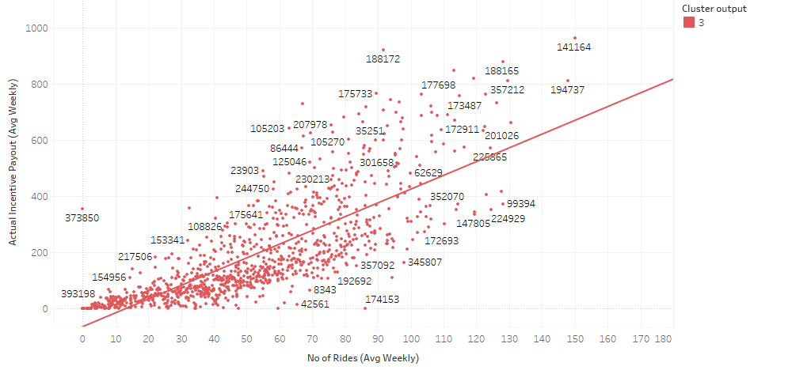
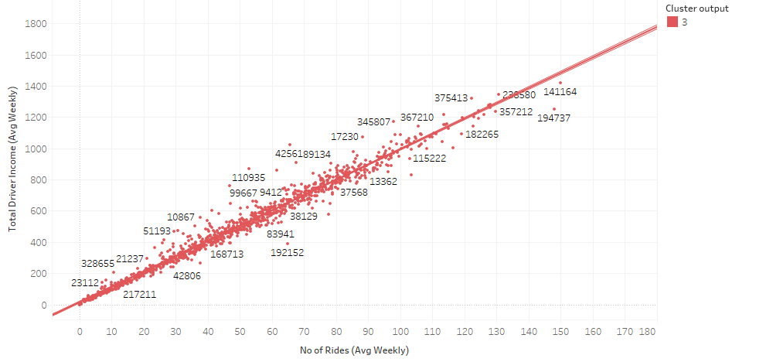
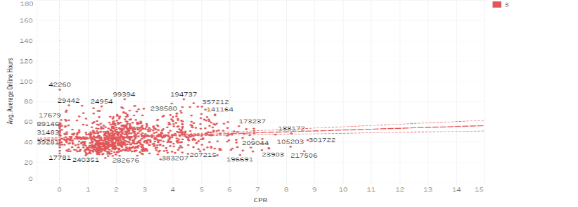
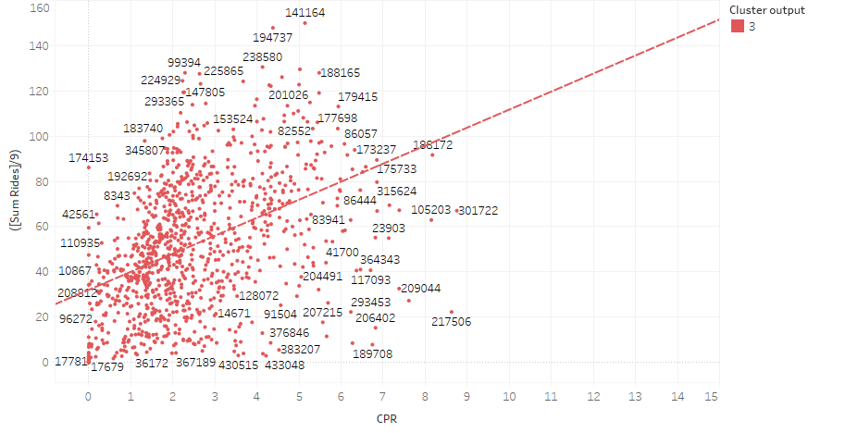
Segment 3
CPR
Consistency in activity
Incentive vs. rides
Income vs rides
Average online hours vs CPR
Weekly sum of rides vs CPR
Acceptance rate
Average lifetime trips
Cancellation rate

Slide 43
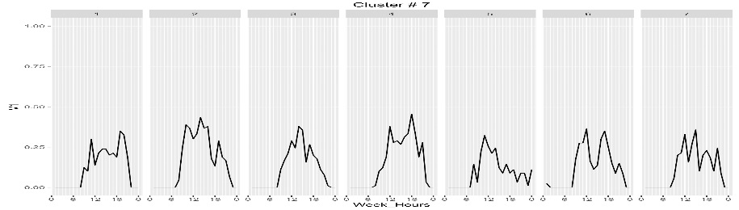
Day time drivers
7am
6pm
7am
6pm
7am
6pm
Who are they?
Daily consistent driving activity throughout the day
Size of cluster: 1855 (14%)
Avg. CPR: $1.40
96% drivers complete under an average of 50 trips in a week
High % drivers of Uber users
Majority of drivers responded to “Extra cash top-up without any target”
Average = 42%
Implications
Incentive payout
Uber user
Though they are consistently driving daily throughout the day, their weekly rides fall under 50 rides and they tend to respond more towards “without target” type schemes. Grab can focus on incentives that encourage more trips and long term commitment.
Weekly trips
Tenure

Slide 44
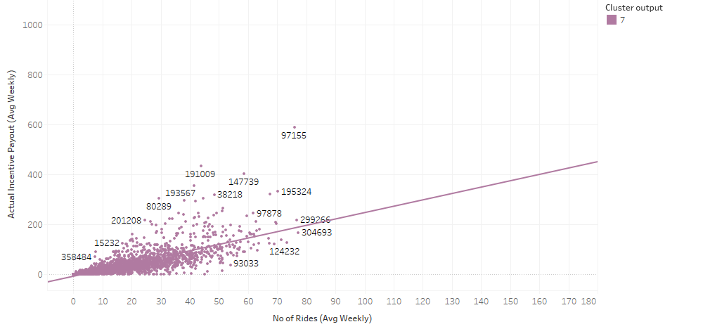
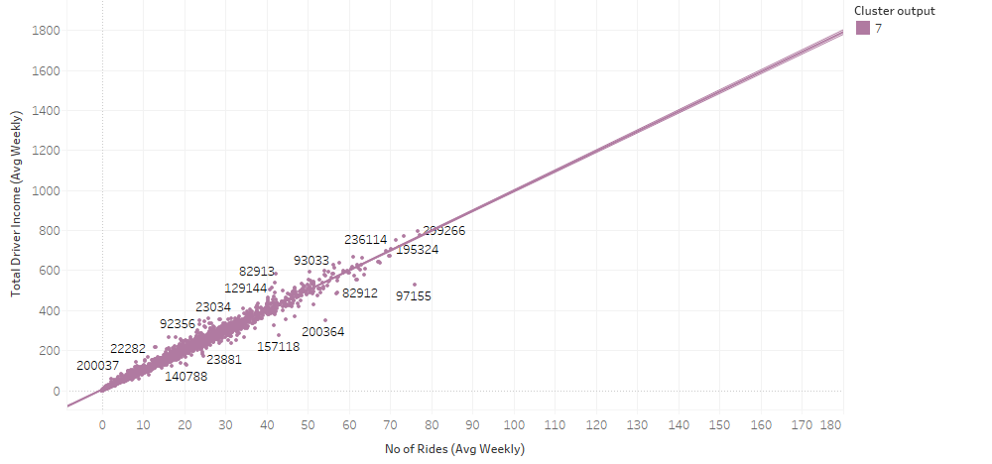
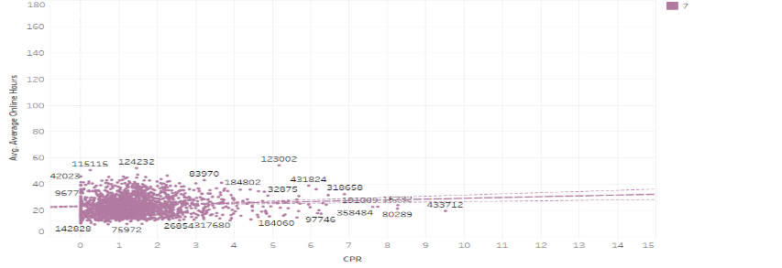
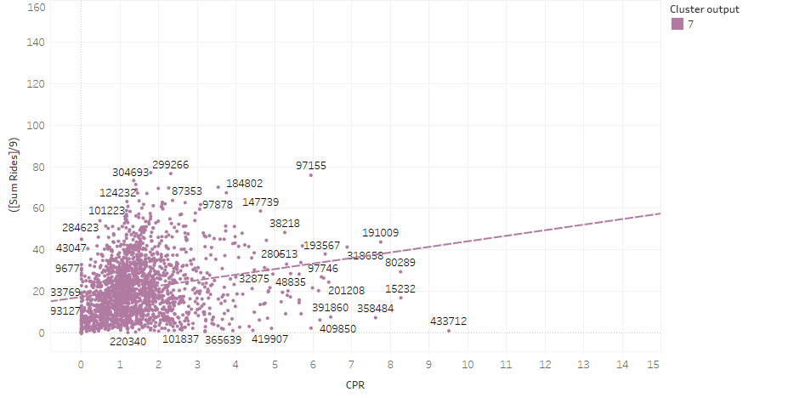
Segment 7
CPR
Consistency in activity
Incentive vs. rides
Income vs rides
Average online hours vs CPR
Weekly sum of rides vs CPR
Taxi license
Average lifetime trips
Fuel card
Average = 14%
Average = 6%

Slide 45
Evening peak/night drivers
Who are they?
Size of cluster: 1355 (10%)
Avg. CPR: $1.60
60% of the drivers with tenure less than 6 months
Over 50% of drivers are between the ages of 25-40 years old
High % of drivers make 50 trips or less in a week
Late night driving
Age
Cancellation rate
Implications
Average = 23%
This segment represents drivers who are meeting the evening peak demand. Grab may consider offering incentives aimed at maximizing their evening and weekend capacity, since there is a large proportion of drivers who are making under 25 trips in a week.
Fleet exclusivity
Weekly trips
Average = 6%
Fuel card
Tenure

Slide 46
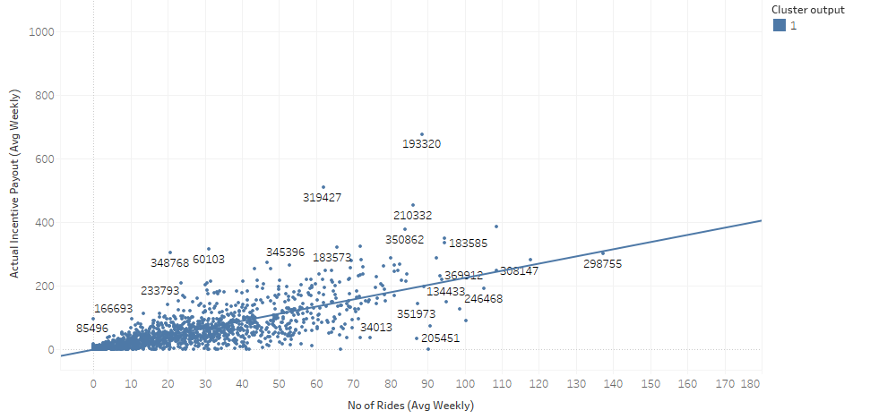
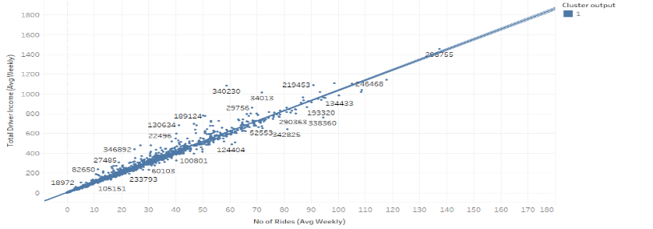
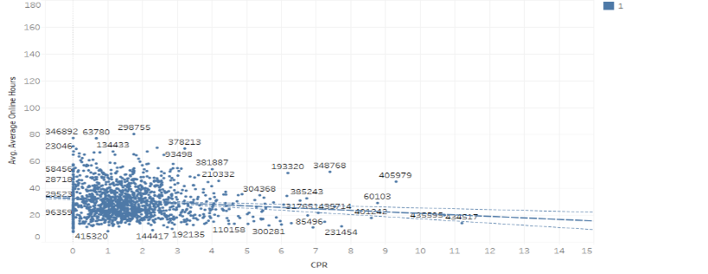
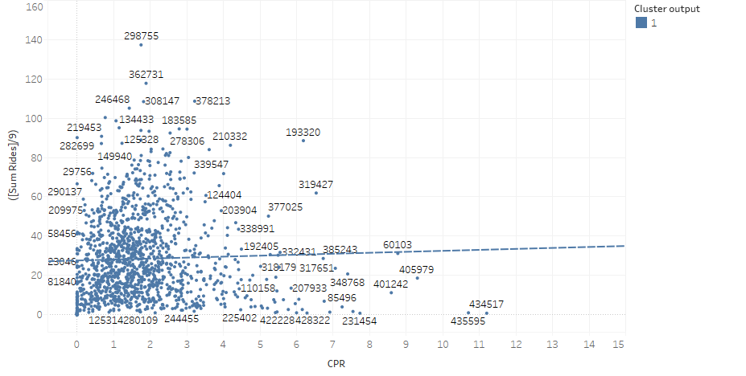
Segment 1
CPR
Consistency in activity
Incentive vs. rides
Income vs rides
Average online hours vs CPR
Weekly sum of rides vs CPR
Uber user
Average lifetime trips
Taxi license
Average = 42%
Average = 14%

Slide 47
Evening peak/night drivers
Who are they?
6 pm
6 pm
6 pm
Size of cluster: 1336 (10%)
Avg. CPR: $1.40
60% drivers are between the ages of 25 to 40.
Relatively new to Grab (61% less than 6 months)
Over 90% of drivers made 50 or less trips in a week
Evening peak and night driving behavior
Average = 14%
Incentive payout
Taxi license
Implications
The driving activity of this segment appears to be constrained by evening peak hours and a large % of drivers have the ability to qualify for incentives with target fares. It is recommended that we maintain their current incentive schemes offered.
Age
Weekly trips
Tenure
Notes:
Segment 4:

Slide 48




Segment 4
CPR
Consistency in activity
Incentive vs. rides
Income vs rides
Average online hours vs CPR
Weekly sum of rides vs CPR
Fleet exclusivity
Average lifetime trips
Uber user
Average = 42%
Average = 23%

Slide 49
High activity AM peak drivers
Average = 23%
Who are they?
Fleet exclusivity
Highly intense morning peak drivers
Size of cluster: 1383 (11%)
Avg. CPR: $2.90
51% of drivers age above 45 yo
45% of drivers have tenure between 6-1.5 years
Highest response towards loyalty program type of schemes
Acceptance rate
Implications
One of the two most important segments to Grab in meeting morning peak hour demands. The CPR for this segment is relatively similar to the overall average CPR of $2.70, hence Grab could introduce incentives aimed at maximizing their trip capacity for morning peak hours.
Incentive payout
Age
Average = 6%
Fuel card
Tenure
Notes:
Segment 6

Slide 50




Segment 6
CPR
Consistency in activity
Incentive vs. rides
Income vs rides
Average online hours vs CPR
Weekly sum of rides vs CPR
Average weekly trips
Average lifetime trips
Uber user
Average = 42%

Slide 51
High activity 2 peak drivers
Average = 23%
Who are they?
Size of cluster: 1854 (15%)
Avg. CPR: $3.60
75% of the drivers with tenure more than 6 months
Over 51% of drivers over the age of 45
Highest percentage of fuel card users, fleet exclusive along with highest response to loyalty type programs
Highest percentage of more than 1000 lifetime trips
Age
Fleet exclusivity
Weekly trips
Lifetime trips
Average = 6%
Implications
Most important to Grab because they currently meet the demands for both evening and morning peak hours and are the most loyal in terms of fleet exclusivity and fuel card users. However they are also the most expensive segment, where their CPR is more than double that of the evening/ night time peak hour drivers. Grab may maintain this segment to meet their peak hour demands, however at a later stage should consider revising their incentives offered to this segment, once peak hour demands are being sufficiently met through other driver segments.
Incentive payout
Fuel card
Dual peak hour driving
Notes:
Segment 8

Slide 52




Segment 8
CPR
Consistency in activity
Incentive vs. rides
Income vs rides
Average online hours vs CPR
Weekly sum of rides vs CPR
Uber users
Taxi license
Tenure
Average = 42%
Average = 14%

Slide 53
Least active drivers
Who are they?
Size of cluster: 2581 (20%)
Avg. CPR: $0.90
Highest percentage of Uber users
Lowest percentage of fuel card consumption
Acceptance rate
Cancellation rate
Average = 42%
99% of the drivers who complete less than 25 trips weekly
Further sub-clustering was performed to examine if any similarities exist between the sub-clusters and other segments.
Uber user
Weekly trips
Implications
This segment represents the largest cluster and they have the highest propensity to churn. Grab may consider incentive schemes that will encourage an increase in their online activity, so as to uncover their inherent driving behavior
Incentive payout
Lifetime trips
Average = 6%
Fuel card
Tenure
Notes:
Segment 2

Slide 54
Evening peak oriented drivers
Who are they?
Size of cluster: 1588 (12%)
Avg. CPR: $2.70
50% of drivers are aged between 25-40 years old
This segment has the highest response towards loyalty programs
73% drivers made < 50 weekly trips
Age
Weekly trips
Implications
This segment is important in meeting the evening peak hour demands at the average CPR. Grab can consider proposing incentives aimed at increasing their number of rides during their evening hour peak hour driving.
Incentive payout
Average = 42%
Uber user
Tenure
Notes:
Segment 5

Slide 55




Segment 5
CPR
Consistency in activity
Incentive vs. rides
Income vs rides
Average online hours vs CPR
Weekly sum of rides vs CPR
Taxi license
Average lifetime trips
Fuel card
Average = 14%
Average = 6%

Slide 56




Segment 2
CPR
Consistency in activity
Incentive vs. rides
Income vs rides
Average online hours vs CPR
Weekly sum of rides vs CPR
Age
Fleet exclusivity
Taxi license
Average = 23%
Average = 14%

Slide 57
Segment 7 Fleet exclusivity
Segment 4 Fuel card
Segment 4 Fuel card
Average = 23%
Average = 6%
Income vs rides
Average online hours vs CPR
Weekly sum of rides vs CPR
Acceptance rate
Average lifetime trips
Cancellation rate

Slide 58

Least active drivers (2A)
Segment 2A Summary
Age
AR
Size of cluster: 167 (6%)
Avg. CPR: $0.74
60% of drivers’ age above 35 years old
All drivers’ tenure are more than 9 months
Driving pattern
CR
Segment 2A Summary
66% of drivers with avg AR above 85%
83% of drivers with avg CR below 5%
No driver completes avg more than 25 trips weekly
60% of drivers complete average less than 1000 trips in their lifetime with Grab
Mostly active on Tuesday
Weekly trips
Life time trips
Tenure
Notes:
Most recent converts into UNIFI service (and most recent customers as well). Somewhere in the middle of their contracts, and are “stuck” on VIP products.
Unwilling to upgrade. Focus on education to stimulate growth.
Have they been excluded from current upgrade campaigns?
These could be STX customers who converted to UNIFI about a year back.
Target selectively and cautiously to avoid customers going into the “Bad Payer” segment.
This group may represent younger customers who are more mobile, so OTT, iFlix, etc may be good campaigns

Slide 59

Least active drivers (2B)
Segment 2B Summary
Age
AR
Size of cluster: 1942 (75%)
Avg. CPR: $0.92
74% of drivers’ age below 45 years old
95% of drivers with tenure between 9 months to 1.5 years
Segment 2B Summary
Driving pattern
CR
46% of drivers with avg AR below 85%
83% of drivers with avg CR below 5%
No driver completes aavg more than 25 trips weekly
Only 24% of drivers completed avg more than 1000 trips in lifetime with Grab
Activity remains insignificant for the period
Weekly trips
Life time trips
Tenure
Notes:
Most recent converts into UNIFI service (and most recent customers as well). Somewhere in the middle of their contracts, and are “stuck” on VIP products.
Unwilling to upgrade. Focus on education to stimulate growth.
Have they been excluded from current upgrade campaigns?
These could be STX customers who converted to UNIFI about a year back.
Target selectively and cautiously to avoid customers going into the “Bad Payer” segment.
This group may represent younger customers who are more mobile, so OTT, iFlix, etc may be good campaigns

Slide 60

Least active drivers (2C)
Segment 2C Summary
Age
AR
Size of cluster: 472 (18%)
Avg. CPR: $1.15
82% of drivers’ age above 30 years old
53% of drivers’ tenure is between 1 to 1.5 years
Segment 2C Summary
Driving pattern
CR
38% of drivers with avg AR above 95%
72% of drivers with avg CR below 5%
7% of drivers completed avg 25 – 50 trips weekly
85% of the drivers completed average of more than 1000 trips in the lifetime with Grab
Irregular activity pattern throughout the week
Weekly trips
Life time trips
Tenure
Notes:
Most recent converts into UNIFI service (and most recent customers as well). Somewhere in the middle of their contracts, and are “stuck” on VIP products.
Unwilling to upgrade. Focus on education to stimulate growth.
Have they been excluded from current upgrade campaigns?
These could be STX customers who converted to UNIFI about a year back.
Target selectively and cautiously to avoid customers going into the “Bad Payer” segment.
This group may represent younger customers who are more mobile, so OTT, iFlix, etc may be good campaigns

